Slide 1
Biodiversity for National Parks
Analysis of Observations and Species
Presented by: U.Ujam

Slide 2
Executive Summary
Two data sets were analysed
Endangered Species
Sheep – Foot and Mouth Reduction
Some living organisms appear to be more protected than others. The data shows Mammals are better protected than plants
Some initial observations could be explained by chance. But we found certain species are more likely to be endangered than others.
The sample size required to determine a reduction in Foot and Mouth amongst sheep was 870 (510)

Slide 3
Endangered Species
Mammals 17.8% appear to be the most protected species followed closely by Birds.
Least protected animals are Vascular Plants at 1.03%. Plants are not protected very much.
Are certain types of species more likely to be endangered?
We initially saw that there was a slight difference in the percentages of birds and mammals that fall into a protected category. Our null hypothesis here is that this difference was a result of chance.

Slide 4
Endangered Species
When we ran our chi-squared test, we found a p-value of ~0.688, so we can conclude that the difference between the percentages of protected birds and mammals is not significant and is a result of chance.
But, when we compared the percentages of protected reptiles and mammals and ran the same chi-squared test, we calculated a p-value of ~0.038, which is significant.
Therefore, we can conclude that certain types of species are more likely to be endangered than others.

Slide 5
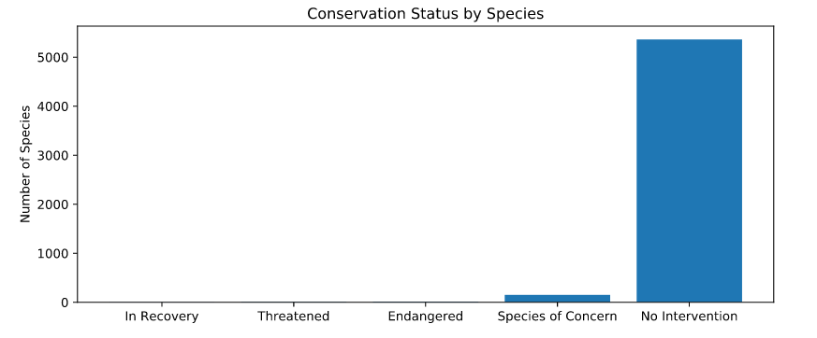
Conservation Status by Species

Slide 6
species_info.csv
Species_info.csv consisted of four main columns:
Category
scientific_name
common_names
conservation_status
Conservation Status provided information as to the likelihood of a species going extinct

Slide 7
species_info.csv
The entire dataset had to be cleaned up. Especially where conservation_status cells were left empty or null
Majority (5363) of the species required no intervention or protection
Birds were the most protected, by number. However, the chi square analysis showed this was not statistically significant when compared to Mammal.

Slide 8
Observation
National Parks Observation exercise for the reduction of the occurrences of Foot and Mouth disease in sheep.
For this exercise data was provided in csv format – observations.csv
To glean insights into the data, the comma separated information had to be filtered for just sheep

Slide 9
Observations
Observations data was merged with species data to generate more accurate dataset of sheep varieties and sightings across various National Parks.
The baseline for the previous year’s reduction in Foot and Mouth was 15%
As a result, 15% was used as the baseline for this data set

Slide 10
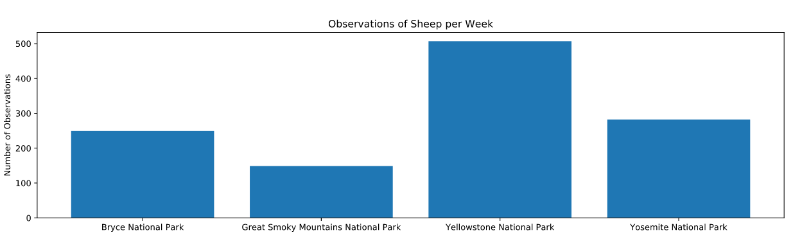
Observations of Sheep per Week

Slide 11
Observations
The National Park wanted to detect reductions of at 5 percentage points
MDE – Minimum Detectable Effect (or Lift) had to be calculated in order to determine the Sample Size.
MDE formula→ 100 * ((0.2 – 0.15) / 0.15) which yields a value of 33.3%
Sample size was a bit of a challenge with the codecademy site giving 870 whilst optimizely gives 510

Slide 12
Observations – A/B Testing
The upshot? The number of weeks the scientists will have to observe sheep in the Yellowstone National Park was 1 week depending on the sample size used
Sheep in Bryce National Park will have to be observed for 2 weeks approximately (or 870 / 250 = 3.48 weeks)

